Slide 1

NLP Sentiment Analysis Project
Modeling Twitter Data Using TF-IDF and Logistic Regression
By:
Pamela Godia, Austine Otieno & Allan Ofula

Slide 2

GOALS & OBJECTIVES
To automate sentiment classification of tweets using natural language processing (NLP) and machine learning thus enabling businesses to:
Monitor customer feedback and public sentiment in real time
Customer service and brand reputation management
Proactively address negative feedback and amplify positive engagement
Monitor public perception of campaigns
Reduce churn by acting on sentiment early

Slide 3
KEY BUSINESS QUESTIONS
Can we accurately predict the sentiment of a tweet using its text content alone?
What are the most frequent words associated with each sentiment?
How well can a classical model (like Logistic Regression) perform compared to more complex alternatives?
What preprocessing steps are most effective for handling noisy, short-form social media text?
Is the model accurate and interpretable enough to deploy for real-time use?

Slide 4
DATA UNDERSTANDING
Dataset: 1.6 million pre-labeled tweets from a sentiment analysis corpus.
Columns: target (label), ids, date, flag, user, text
Label Distribution: Balanced (50% positive, 50% negative)
Unique Users: 660K

Slide 5
SUMMARY
1. Data Preparation:
Cleaned 1.6M tweets by removing noise, stop words, and punctuation. Tokenization and normalization ensured the text was ready for modeling.
2. EDA Insights:
Positive and negative sentiments were evenly distributed.
Word clouds and token frequency visualizations highlighted common emotional expressions.
Tweet length distributions showed that most tweets range between 10–25 words.
3.Modeling:
Trained and compared three models:
Logistic Regression (Best performer: 76.4% accuracy)
Naive Bayes (75.2% accuracy)
Random Forest (75.1% accuracy on sampled data)
Hyperparameter tuning with GridSearchCV was conducted to optimize Logistic Regression.

Slide 6

4. Model Comparison & Interpretation:
Logistic Regression achieved the highest F1-score and recall, making it the most effective for detecting positive sentiments.
5. Error Analysis:
Extracted misclassified tweets revealed limitations where models struggled with sarcasm, ambiguous context, or informal language.
6. Business Value:
This solution provides a scalable, interpretable, and near real-time tool for sentiment monitoring- empowering businesses to understand public opinion, track brand sentiment, and enhance decision-making based on social media feedback.

Slide 7
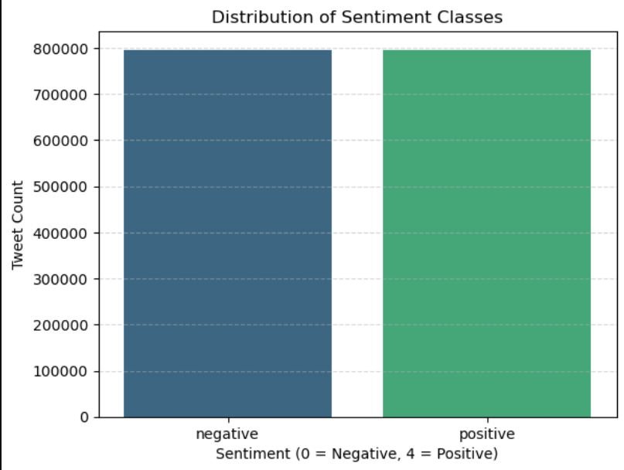
There are 796,109 positive tweets and 796,297 negative tweets.

Slide 8
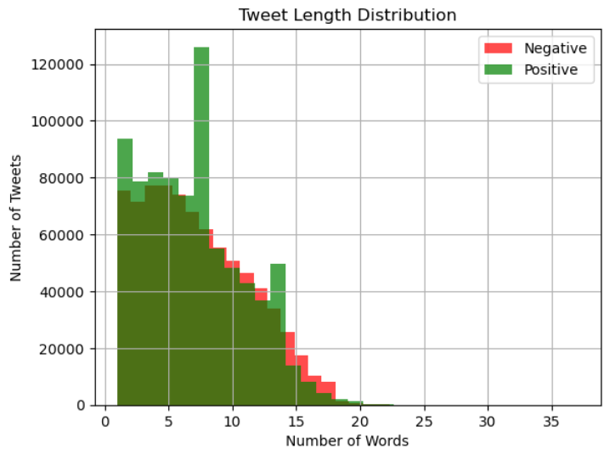
Most tweets, both positive (green) and negative (red) are between 2 and 10 words long. Positive tweets appear more frequently in shorter lengths (especially around 4 and 8 words).

Slide 9
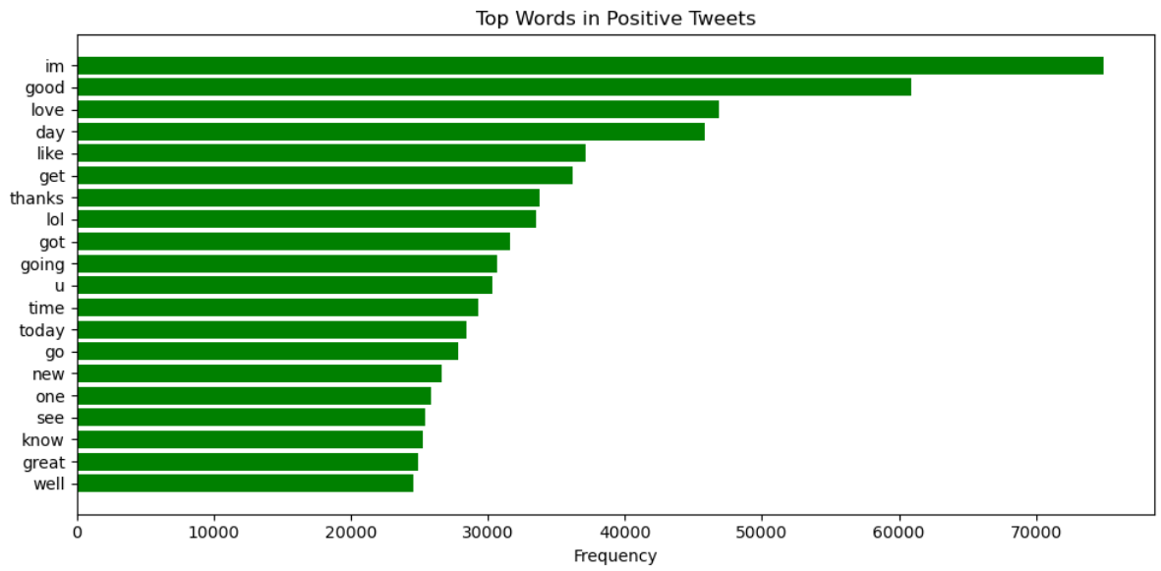
Words like "love“, "thanks”, "good”, "great“, "Well" point toward positive sentiment.

Slide 10
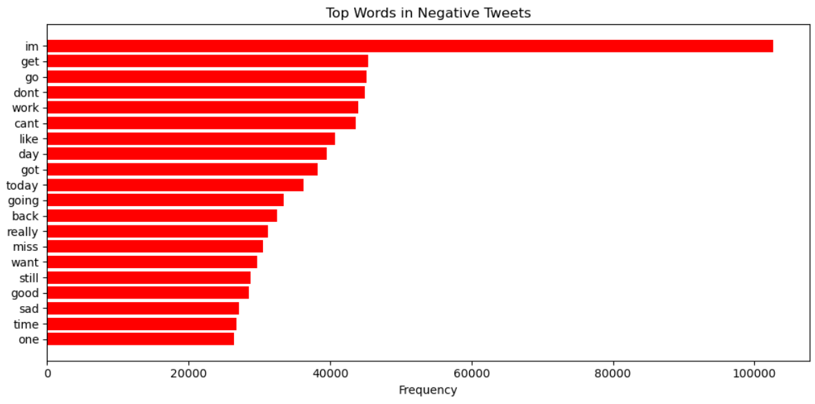
Words such as "sad“ "miss“ "can’t “ "don’t “ indicate negative sentiment.

Slide 11
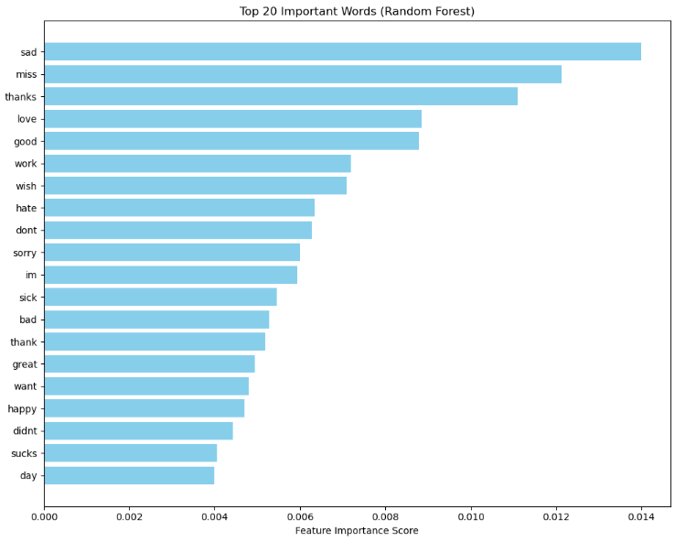
X-axis: Feature importance score — this indicates how influential a word is in determining the sentiment. y-axis: Words (features) extracted from tweets using TF-IDF vectorization.

Slide 12
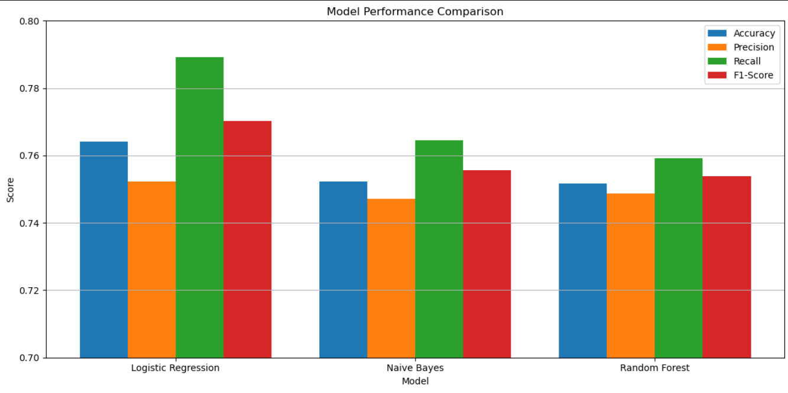
Logistic Regression: performed the best overall, achieving the highest accuracy (76.4%), recall (78.9%), and F1-score (77%) Naive Bayes: was slightly behind, showing solid precision but lower recall than Logistic Regression. Random Forest: despite its complexity, performed similarly to Naive Bayes, but did not outperform Logistic Regression.

Slide 13
CONCLUSION
Based on both the quantitative metrics and visual comparison, Logistic Regression is the best-performing model for this sentiment analysis task.
It balances precision and recall well, making it ideal for real-world deployment where both false positives and false negatives matter.

Slide 14
RECOMMENDATIONS
1. Adopt Logistic Regression for Deployment
2. Expand to Include Neutral Class
3. Regularly monitor misclassified tweets to identify edge cases
e.g (sarcasm & slang)
4. Optimize for Speed and Scale

Slide 15
NEXT STEPS
1. Implement Deep Learning Models (BERT, LSTM)
2. Real-Time Sentiment Dashboard
3. Integrate Topic Modeling (LDA/NMF)
4. Geolocation and Time-Based Analysis
5. API Deployment

Slide 16
THANK YOU

